Slide 1

Module 1:
Introduction to Hospice Palliative Care And The Role Of The Volunteer

Slide 2

What Is Hospice Palliative Care
Hospice Palliative care:
Aims to relieve suffering and improve the quality of living and dying people with terminal
Focus on caring ,not curing.
Neither hastens or postpones death.
Strives to help patients and families address physical ,psychological,social,spiritual and practical issues.
Five aspects of care:
Quality of life
Pain and symptom control.
Comfort and support for the person and family.
Awareness of the psychological ,social,and spiritual sides of life.
Open communication between the person/family and the care team.

Slide 3
2. Principles Guiding Hospice Palliative Care
Patient/Family Focused Care
Quality Care
Comprehensive and Coordination
Safe and Effective Care
Accessibility
Advocacy
Self- Care

Slide 4

3. The Hospice Palliative Care Team
Work together to :
  Achieve common goals.
Committed :
  To patient and family goals and other team members.
Share :
  Values and beliefs about what they are doing and why.
Understand:
  Their roles ,responsibilities,and structures.
Know :
  Where they fit in the team and how their roles work with those of the other team members
Share:
  Relevant information
Do:
  The jobs and tasks they agreed to perform.

Slide 5
4. The Role of The Volunteer On The Team
Companionship and emotional support
  Talk,listen to, and be there for the client.
Comfort
Encouragement
Practical assistance
Informational support
Respite care
Spiritual/religious support
Grief and bereavement support
Advocacy

Slide 6
5. Who Makes a Good Hospice Palliative Care Volunteer?
Characteristics of a good hospice volunteer:
Good Listeners
  Being comfortable with silence and active listening
Empathetic
  Compassion and concern for others
Extroverted
  Sociable,warm,friendly
Agreeable
  Altruistic and trustworthy
Open and Non Judgemental
Culturally sensitive
  Aware of cultural differences and respectful of each person's beliefs and differences
Trustworthy
  Dependable and respectful of persons right to privacy and confidentiality.

Slide 7

6. Understanding Boundaries or Limits of The Volunteer Role
Don’t:
Accept money
Lend Money
Do persons banking
Agree to be power of attorney
Agree to witness patients will
Share personal info about previous patients
Discuss patients diagnosis of prognosis with other family members
Discuss patient or family with others in the community
Provide medical care (medication) to patient who is uncomfortable
Gossip
Proselytize or attempt to cover patient to volunteers religious beliefs
Counsel or Advise the person or family member
Become romantically involved with patient, patients family/friends.
Think Twice about:
Buying gift(s) for patient or family member
Lending things to person or family
Share personal info about self unrelated to experience with death and dying
Give business card to a patient or family
Inviting or being invited by patient or family to join activities outside the volunteer assignment
Breaking down emotionally in front of a patient or family.
Attending a patient's medical appointment
Providing opinions or advice to a patient/family

Slide 8
The Responsibilities of The Organization and The Volunteer
To provide support to volunteers in their role the organization will:
Treat volunteers as valued members of the care team and treat all volunteers fairly
Have:
  Up to date policies and procedures
Provide:
  Orientation of the organization
  initial and ongoing training
Give :
  Meaningful assignments that make good use of their knowledge and skills
Ensure:
  Volunteers have the right information and support to fulfill their assignments
Have:
  Available team members to answer questions or concerns
Provide :
  Appropriate constructive supervision and feedback
Recognize volunteers for theri contribution
Organize events to help volunteers:
  Deal with loss
  Take care of themselves.
Volunteers are expected to:
Commit enough time
Be dependable and flexible.
Participate in team meetings. and work as part of the team.
Complete all required training and demonstrate they have achieved desired competencies .
Be open to supervision and feedback.
Adhere to the organizations policies.

Slide 9
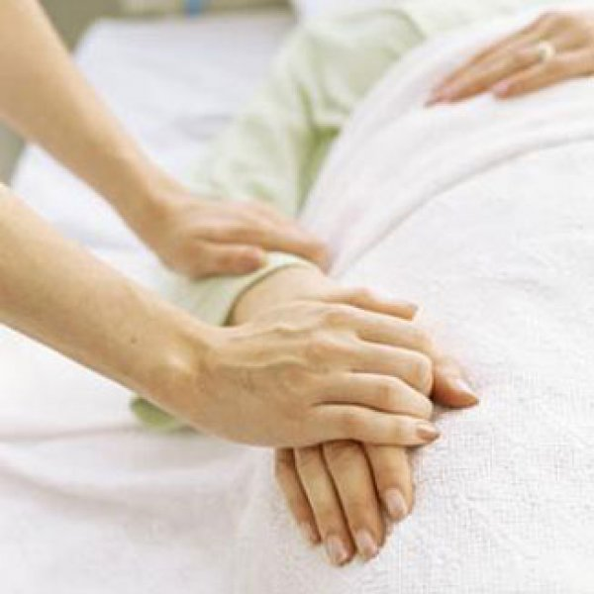

Module 2:
Effective
Communication
Skills

Slide 10
Effective Communication
Communication
What is it?
  Talking:
    More than 80% of the “message” is in the how — not the what
    Express yourself clearly
    Use a “common language” of words and body language
    Ask open-ended questions, and avoid giving advice
  Listening:
    Be available and “present”
    Give undivided attention
    Listen with empathy
    Respect silence

Slide 11

Barriers
Communication
Poor listening skills
Stress
Language and culture
Intense feelings
Secrecy

Slide 12
Active Listening and Empathy
Communication
The first step in communication is listening to one another. Without listening there is little communication, and without communication there is little love. Each of us needs desperately to be listened to, and to be loved by another who can listen to us and love us just as we are.
– Buckman

Slide 13
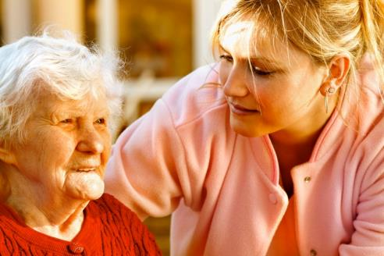
Active Listening and Empathy
Communication
Some guidelines:
  Clear your mind
  Be silent
  Make eye contact
  Relax … and be open
  Be compassionate
  Listen without interruption
  Listen for more than words
  Send acknowledgements
  Use touch — but only with
  permission

Slide 14
When there is a Physical Barrier to Communication
Communication
Communicating with someone who has a speech impairment
  Speak normally — no need to raise your voice
  Be patient
  Ask the person to repeat herself/himself when necessary
  Ask the person to say it in a different way or provide clues in other ways
  Ask if there is someone nearby who can translate for you
Communicating with someone in a coma
  Remember: the person can hear and understand your voice and/or touch
  Look for tiny clues about how the person is feeling, and trust your “sixth sense”
  Speak normally, be relaxed, and express words of encouragement

Slide 15
Techniques that Help
Communication
Using silence
Placing the event in time or in sequence
Encouraging description
Offering general leads
Offering self
Requesting an explanation
Focusing
Encouraging a plan of action
Restating
Accepting
Making observations
Giving broad openings
Giving information
Giving recognition
Attempting to translate feelings
Seeking clarification
Reflecting

Slide 16
Techniques that Hinder
Communication
Story-telling
Advising
Introducing an unrelated topic
Disagreeing
Correcting
Expressing judgement
Offering false reassurance
Educating
Sympathizing
Defending
Using jargon
Making stereotypical comments

Slide 17

What Will I Talk About?
Communication
General tips:
  Before you arrive, review what you know
  Ask open-ended questions
  Be prepared to share information about yourself
  When you arrive, “take the temperature of the room”
  Introduce yourself – and be prepared to do this several times if necessary
  Be yourself
Conversation starters:
  Talk about the person’s home or room
  Ask about the person and family
  Ask about his/her life story
  Discuss what’s happening now or this week
  Explore his/her social interests
  Discuss his/her thoughts and feelings

Slide 18
Privacy and Confidentiality
Communication
Do not disclose:
  who you are caring for
  the state of wellness of the ill person or family members
  anything that is said to you by the person and/or family members
  anything that you observe or overhear during your assignment
  how the person died
  how the family members grieve
Is it ever acceptable to break confidentiality?

Slide 19
Video!
https://www.youtube.com/watch?v=OwW8x_0YGLI

Slide 20
Next Steps?
Click on the link below to take you to the Module 2: Effective Communication Skills quiz section
  Module 2 Quiz

Slide 21

Module 3
Family and Family Dynamics

Slide 22
What is Family?
Definition: People who are emotionally,economically,spiritually , and socially to one another either by birth or by choice.
Families are complex systems that funtion based on:
Roles (Including gender roles)
Who has authority and makes decisions
Communication

Slide 23
The Familys Role in Hospice Palliative Care
Providing Care and Support:
Familys can provide care and support which may look like:
Children become caregivers for parents
Spouse may assume decision role.
The primary person who provided support (inclduing emotional ) may need it.
Spouses take on intimate care tasks such as:
  bathing
  cleaning
  feeding
    This can potentially put the couple relationship on hold.
Receiving Care and Support:
Families can receive care and support , which may look like:
Having resources to educate them on end of life care and death
Being assured that their loved on is receiving the best care
Having resources for coping and bereavement/grief support.
A family’s ability to cope with caregiver burden depends on many factors including their coping skills and social support networks.

Slide 24
The Volunteers Role With The Family
Volunteers support , they don't fix.
Volunteers are not alone.
Volunteers can help families in their caregiving by:
Sharing
  Their knowledge about comfort measures
Being
  Alert to the changing care needs of the dying person and reporting these to the hospice supervisor.
Bringing
  Any concerns about family caregivers ability to continue to provide care to the hospice supervisor.
Helping
  Family members with unfamiliar tasks or reddereing them to resources for help
Giving
  The family members and dying person time to be togther as a family.

Slide 25
Supporting Families
Things you can do as a volunteer:
Take time to listen
Pay attention to family members feelings and changing moods
Offer to keep dying person company so family members can take a break
Remain non-judgemental
Allow family members to express their frustration and anger.
Helping families manage stress and caregiver burnout:
Be aware of caregivers stress level
Encourage caregivers to stay healthy and help them achieve this in practical ways.
Be aware of signs of caregiver burnout and hel caregivers recognize the signs themselves.
Help family members confront any negative feelings and find appropriate ways to deal with them.
Tell the family about community resources that are available.

Slide 26

Module 4
Emotional/Psychological Issues and Support

Slide 27
What is a Good Death?
Many people describe dying well as:
Being pain free
Having a sense of choice and control over what happens in their lives while gradually relinquishing responsibility of care to their loved ones.
Maintaining their dignity and privacy.
Resolving long-standing conflicts.
Satisfying final wishes.
Having time to say goodbye.
Being able to leave when it is time to go and not have life prolonged.

Slide 28
Volunteers Role In Emotional Support
People who are dying and their families need:
Empathy
Permission
  To express their thoughts or feelings and/or needs.
Individuality
  Be treated as a person
  asked about their needs
Advocacy
Truth
Time
Attention
Sensitivity to context
Acknowledgement of needs.
Given time to come to terms with feelings and thoughts.

Slide 29

Module 5
Spiritual Issues and Support

Slide 30
Spirituality At the End of Life
Spiritual care is an integral part of hospice palliative care.Spirituality is a way for people to find meaning in their lives and circumstances.
Some of the ways that people find meaning include:
Belonging to a caring community.
Telling their stories.
Healing old wounds.
Experiencing moments of transcendence or peak experiences.
Feeling valued by others.
Developing one’s higher self or soul.

Slide 31
Providing Spiritual Support
Hospice palliative care volunteers can provide spiritual support by:
Building trust
Encouraging the person to talk about things they have done in their life.
Listening patiently.
Treating the person dignity
Respecting the persons and families belief systems
Sharing personal beliefs.
Never proselytizing or trying to convert
Provide whatever the person or family asks in terms of spiritual support, in terms of contacting their faith leader or community.
Being present even when people want to go into difficult places.

Slide 32
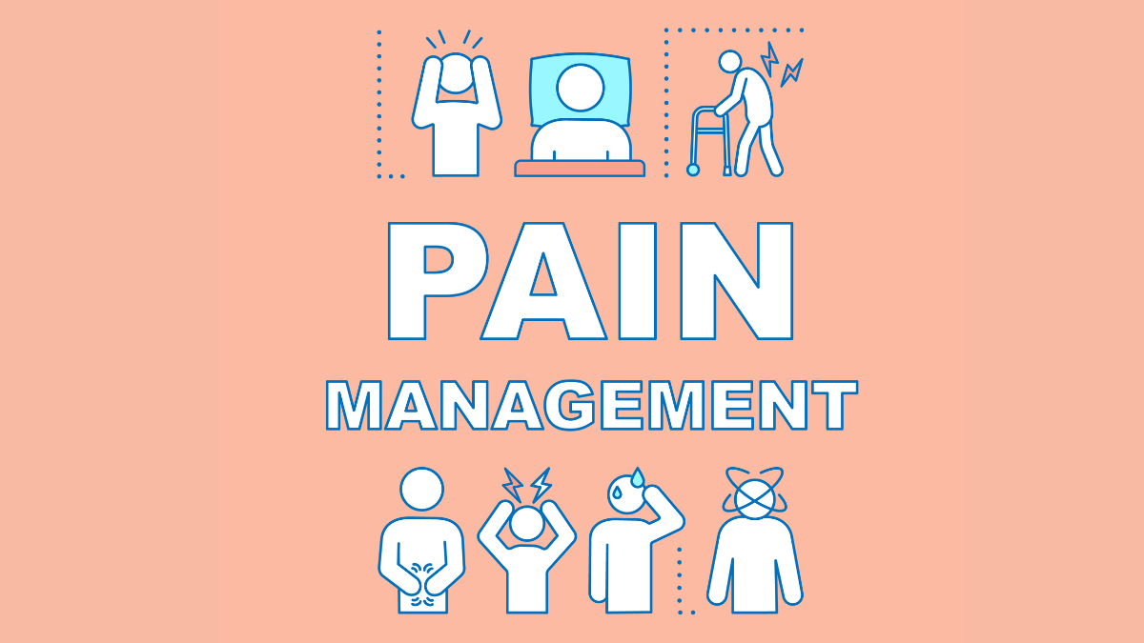
Module 6:
Physical Issues and Support , Including Pain Symptom Management

Slide 33
Common Illnesses
The most common life limiting illnesses seen in palliative care are:
Cancer
Dementia and Alzheimers
Hiv/Aids
End of stage organ failure
It is important for volunteer to suppor the prosn or family by:
Remaining non judgemental
Helping person/or family members to live as fully as possible.
Being alert to the persons changing needs

Slide 34
Symptoms at End of Life
What is a symptom?
Any feeling a dying person has that makes them uncomfortable , restricts their activity , or keeps them awake.
Symptoms may include:
Pain
Loss of appetite
Nausea
Fatigue and exhaustion
Breathlessness
Constipation.

Slide 35
Volunteers Role In Pain Management
Volunteers role is to:
Observe the person.
Provide comfort measures such as:
  Support
  Companionship
Report any signs that the person is in pain to care team.
Volunteers NEVER administer medications.
Volunteers can use their communication skills to help the dying person identify and express how they are feeling.

Slide 36

The Importance of Infection Control
Volunteers are expected to know and use the following standard infection control precautions at all times:
Make sure you have all your immunizations
Wash your hands.
Wear latex gloves if:
  You have any open sores , cuts, cracks on fingers and hands.
  If you have to handle anything that is damp.
    Dispose of gloves immediately after use and wash hands.
Do not visit the person if you have a cold or flu.
Wear a mask if the person is coughing excessively.
NEVER handle needles.

Slide 37
What To Do In Case Of Accidental Exposure?
If you:
Stuck by a needle
Cut or scratched by a razor blade or sharp instrument that could be contaminated with fluids.
Have blood or other body fluids splashed in your eyes or mouth or onto broken skin.
What to do; Remain calm and :
Immediately wash the affected area with soap and water or slush your eyes with cool water.
Contact your supervision to report what happen.
Contact your family doctor to review your exposure and any additional steps you should take.

Slide 38
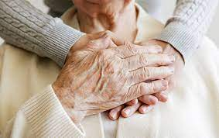
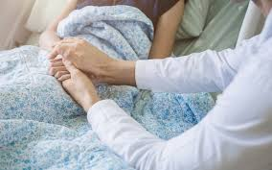
Module 7:
Caring For People at Home or in a Hospice

Slide 39
What Different About Volunteering in Someone's Home Or A Hospice?
Volunteers who are caring for someone at home or hospice may be asked to help with feeding.
Volunteers can help by:
Being sensitive to cultural and religious dietary requirements and how they may influence the feelings and actions of family members.
Normalize the eating experience by encouraging person to adhere to recommendations of healthcare professionals.
Encourage person to try small amounts of food or drink.
Clean persons teeth and mouth before they eat to stimulate taste buds.
Communicate food related needs of person to care team.
Help person participate in family ceremonies and rituals they feel are important to their wellbeing.
Use comfort measures they have learned
Help family members understand persons decreased need for nutrition at the end of life.
Support person/family decisions.
Encourage person/family members discuss their feelings of hope and loss.
Volunteers who are caring for someone at home or hospice may be asked to help with lifting.
Before you lift assess risks and asks yourself:
Am I hurting the client ?
Have I been trained to safely Perform this task?
Is there someone else in the home who can assist with this task?
Remember:
If you dont feel you can safely perform task,ask for assistance or wait until someone arrives who can help.
Check posture (straight back and chin tucked)
Lift with strong leg muscles.
Shift don’t lift (travel shortest distance)
Wear safe footwear
Position equipment and engage the brakes.
Lift first, then turn (Don’t twist)

Slide 40
What to do:If Person Falls/Is Found On The Floor
If the person falls:
Remain calm
Do not attempt to stop a person from falling
Protect his/her head.
Once person is on the floor, there is no hurry. Assess if:
Persons condition has changed
If nothing has changed:
Comfort them
Laugh with them
Wait until help arrives.
DON’T try to help person get up from floor.
Tell family members what happen and reassure them the person is comfortable.
Notify your supervisor.
If you find the person on the floor:
Say the person's name and ask if they are okay
DON’T try to help them get up.
Reassure the person
Call for assistance (Call 992 only if it is a medical emergency)
Tell family members what happened
Notify your supervisor and complete the required Incident Report.

Slide 41

Module 8:
G

Slide 42
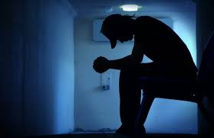
What is Grief and Bereavement?
Grief is a natural response to any type of loss and source of stress for anyone experiencing a loss.
Anticipatory Grief: Grief that someone experiences in expectation of death.
Mourning: A process that helps individuals cope with grief.
  Tasks of grief include:
    Acceptance
    Emotional pain and suffering
    Adjustment to living without a loved one.
    Letting go.
Bereavement: State of suffering a loss.

Slide 43
Needs of People Who are Grieving?
Everyone grieves differently and will have different needs, but most grieving people value:
Being alone
Opportunity to express their feelings without embarrassment.
Opportunity to tell and re-tell stories of the life and death of their loved one.
Information about what is normal (when grieving)
The gift of presence.
Permission to be self-absorbed
Being able to laugh and not feel guilty about having fun.
Permission to experience and express a myriad of feelings.
Help with basic needs like:
  Grocery shopping.
  Housekeeping.
  Meal Preparation.

Slide 44
Myths About Grief
A few myths about grief include:
Keeping busy is the best rememdy when dealing with death of loved one.
Time Heals.
Not talking about death of loved ones or talking about them less makes it easier.
Forget about the dead person.
There is a set time they will adjust to death of loved one.
Having sympathetic people around them prolongs grief.
Protect young children from death and don’t express emotions around them.

Slide 45
How Can Volunteers be Help People with Grief?
Volunteers can help by:
Being with giver in their pain
Affirm grievers value as a person
Allow person to express anger, even towards you.
Explain the process of grieving and emotions that they are experiencing is normal.
Help with necessary decision making , but don’t make the decision.
Give comfort in ways you would appreciate.
Encourage person to develop and maintain friendships.
Watch for escape into addictive patterns.
Recognize grievers vulnerability and help prevent exploitation.

Slide 46
Helping: Children With Grief|Older People With Grief
With children, the volunteer’s role is to affirm the child's feelings and support the adult feelings.
Children should be allowed to share in grief and attend the funeral or wake if they want to.
Children might feel:
Abandoned
Scared
Confused
Guilty (That they may have caused death).
Older people may be or have already experienced losses over the course of their lifetime.
To help them volunteers may:
Explore their history loss
Give opportunity to describe and find meaning in their losses and change.
Encourage them to talk about their feelings and acknowledge pain.
Grief work is meant to uplift and bring relief.

Slide 47

Module 9
Self Care

Slide 48

What Is Stress?
Stress: The body's way of responding to demands.
A few symptoms of stress include:
Muscle Tension
Pounding heart
Sweating
Dry mouth
Butterflies in the stomach
Fatigue
Apathy or depression
Being overly emotional
Loss of enjoyment
Irritability
Racing thoughts and inability to “switch off”.

Slide 49
The Stressors Of Being a Hospice Palliative Care Volunteer
Various Factors can cause stress for the hospice palliative care volunteer including:
Factors related to the dying ersoon such as problems with symptom control, psychiatric or personality issues and anger or anxiety over dying.
Trying to support a dysfunctional family.
Workload.
Lack of :
  clarity about their role
  communication or conflict with other team members
  resources or administrative problems in program.
Balancing their volunteer responsibilities with their personal or professional life.
Stressors in personal life.
Inadequate training
Unrealistic expectations for themselves.
The challenge of “being” with someone rather “doing “ for them.

Slide 50
Strategies to Manage Stress
Reflection is an intricate part of self care. The things you can do for reflection are:
Journal
Talk to friend.
Have a supportive network of people and resources around you who:
Accept you unconditionally.
Can share with at a deep level.
Have fun and refresh your soul by:
Exercise
Reading
Painting
Relax
Anything that you can do to relieve your stress that’s healthiest for you.

Slide 51
Strategies to Manage Stress Cont’d
Revisit Boundaries:
It Is important to set boundaries with the person and family to:
Define your role and what you can and cannot do.
If you don’t set or keep your boundaries you may find yourself becoming overwhelmed and resentful.
Personal boundaries imply meeting your own needs before meeting the needs of others.
Remember!:Boundaries are not selfish, but a way to stay healthy.
If you feel you are stuck or overwhelmed take some time to:
Stop
Rest
Assess your needs.

Slide 52
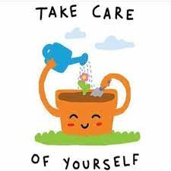
The Volunteer Self Care Kit
Be gentle with yourself
Ask for help when you need it.
Give timely support, encouragement and praise to others on the team and learn to accept it for yourself.
Value the relationships you have
Get to know your own strengths.
Learn to recognize tbe difference between complaining that relieves and complaining that reinforces stress.
Let off steam
Change routine
Practice saying “no” so that you can set limits when you need to.
Take a step back.

Slide 53

You Made It!

